Slide 1
IST718 Bias-variance tradeoff: simulations
Willard Williamson
Adjunct Professor
iSchool, Syracuse University
linkedin.com/in/ncc-1701-d

Slide 2

Simulations
Look at the following fake data: $f\left(x\right)=10+5x+0.5x^{2}−0.1x^{3}$

Slide 3
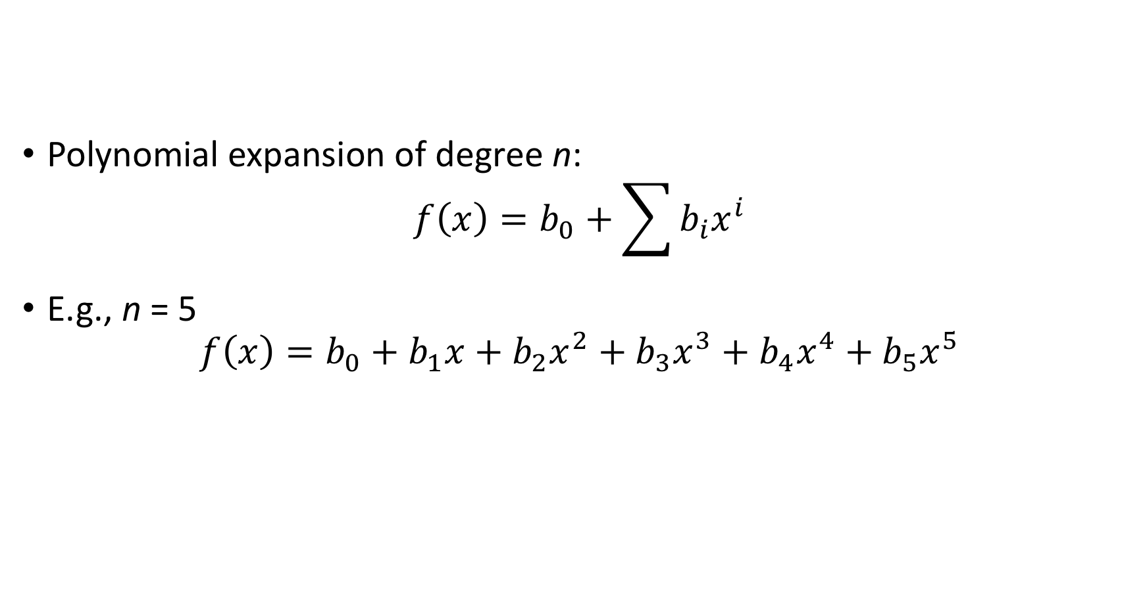
Let’s fit several models with increasing complexity
Polynomial expansion of degree n: $f\left(x\right)=b_{0}+\sum{b_{i}x^{i}}$
E.g., n = 5 $f\left(x\right)=b_{0}+b_{1}x+b_{2}x^{2}+b_{3}x^{3}+b_{4}x^{4}+b_{5}x^{5}$

Slide 4
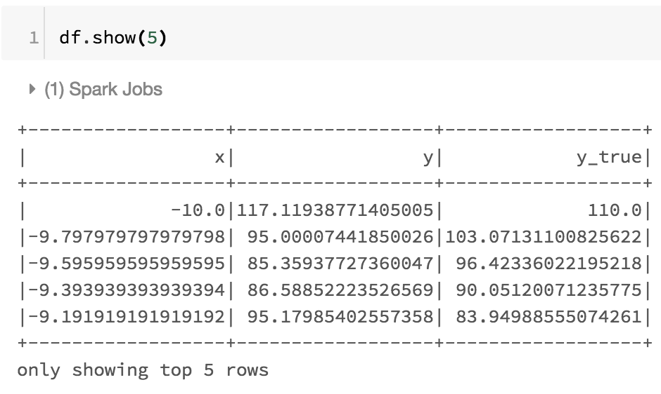
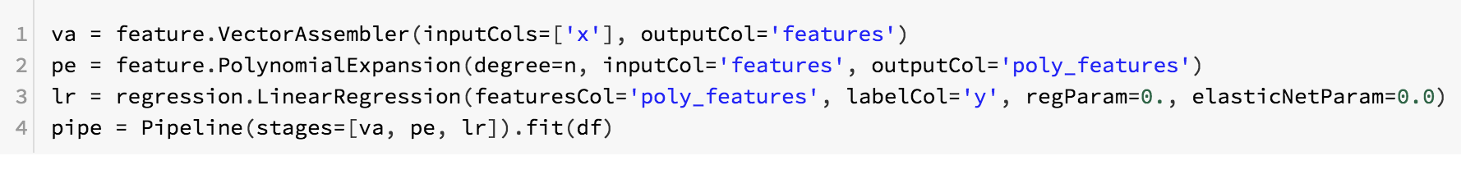
We will systematically fit different n

Slide 5
Polynomial Expansion
The PolynomialExpansion object in the previous slide expands feature columns into a polynomial space by performing an n-degree combinations of the original data dimensions.
This is a form of feature engineering
https://spark.apache.org/docs/latest/ml-features.html#polynomialexpansion

Slide 6
Models
n = 1

Slide 7
Models
n = 2

Slide 8
Models
n = 3

Slide 9
Estimate the bias and variance

Slide 10
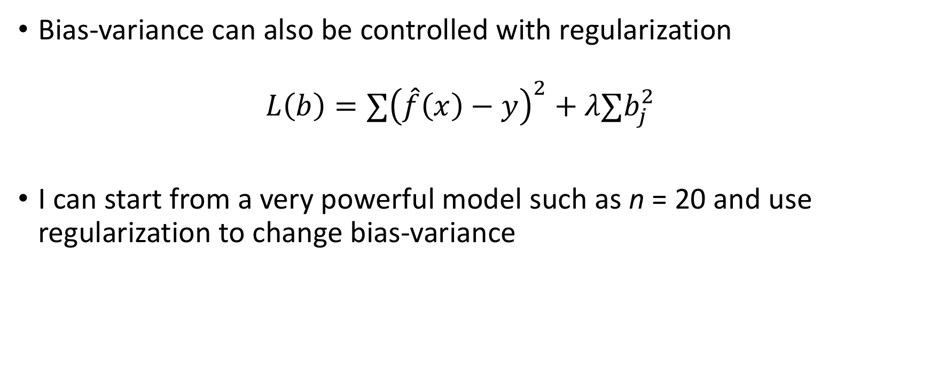
Regularization
Bias-variance can also be controlled with regularization $L\left(b\right)=∑{\left(\hat{f}\left(x\right)−y\right)}^{2}+λ∑b_{j}^{2}$
I can start from a very powerful model such as n = 20 and use regularization to change bias-variance

Slide 11
Model n = 20 with regularization
Lambda = 1000

Slide 12
Model n = 20 with regularization
Lambda = 100.

Slide 13
Model n = 20 with regularization
Lambda = 0.1

Slide 14
Model n = 20 with regularization
Lambda = 0

Slide 15
You can also look at the coefficients
Coefficients become smaller due to regularization; this is known as shrinkage in statistics
Legend contains first 8 coefficients of 20

